Slide 1
Lecture 4: Curvature, Torsion, and Frenet Formula
Math 142
Prof. Gu

Slide 2
Review the concept of “a curve is parametrized by arclength”
Key:
C(s) is perpendicular to C’(s).
Prove it!

Slide 3
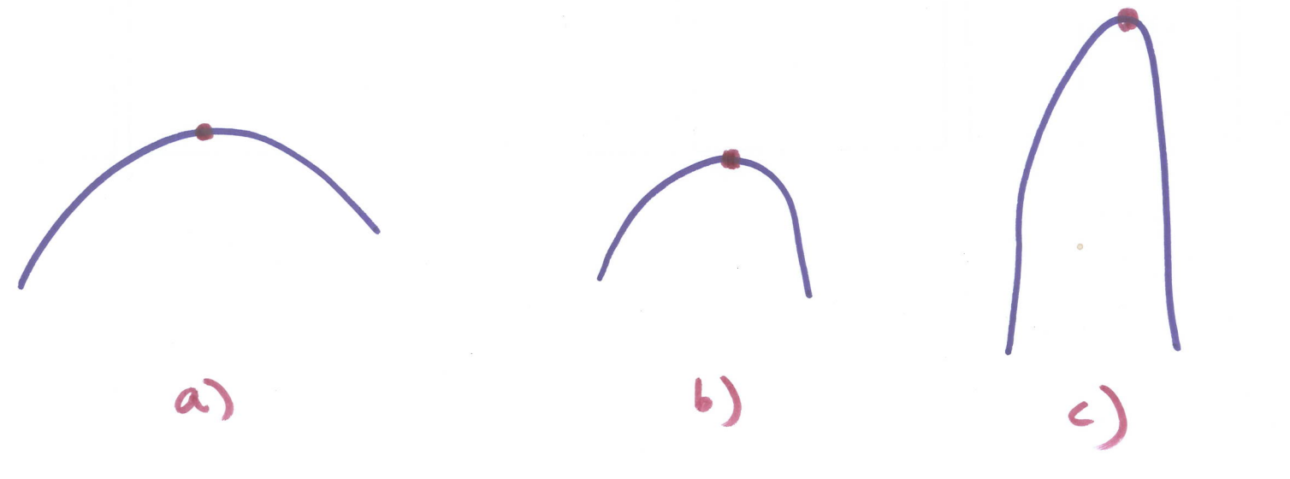
What are the differences between the following curves near the top points?

Slide 4
Curvature
Use the above observations to give the definition of Curvature.
All the details can be found in Topic 1 on Regular curves.

Slide 5
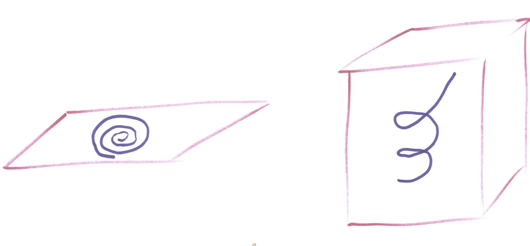
What are the differences between following two curves?

Slide 6
Torsion
Use the above observations to give the definition of Torsion.
All the details can be found in Topic 1 on Regular curves.

Slide 7
Frenet Formulas
Derive Frenet Formulas in detail on the board.
Then put them into a matrix representation.
(Ask student to take the notes since they will use them in their homework.)
All the details can be found in Topic 1 on Regular curves.

